Slide 1
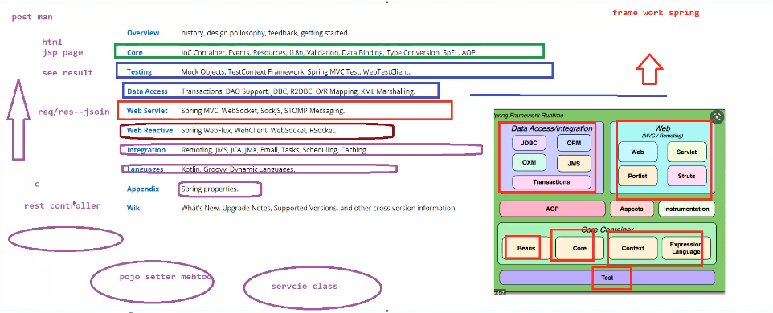

Slide 2
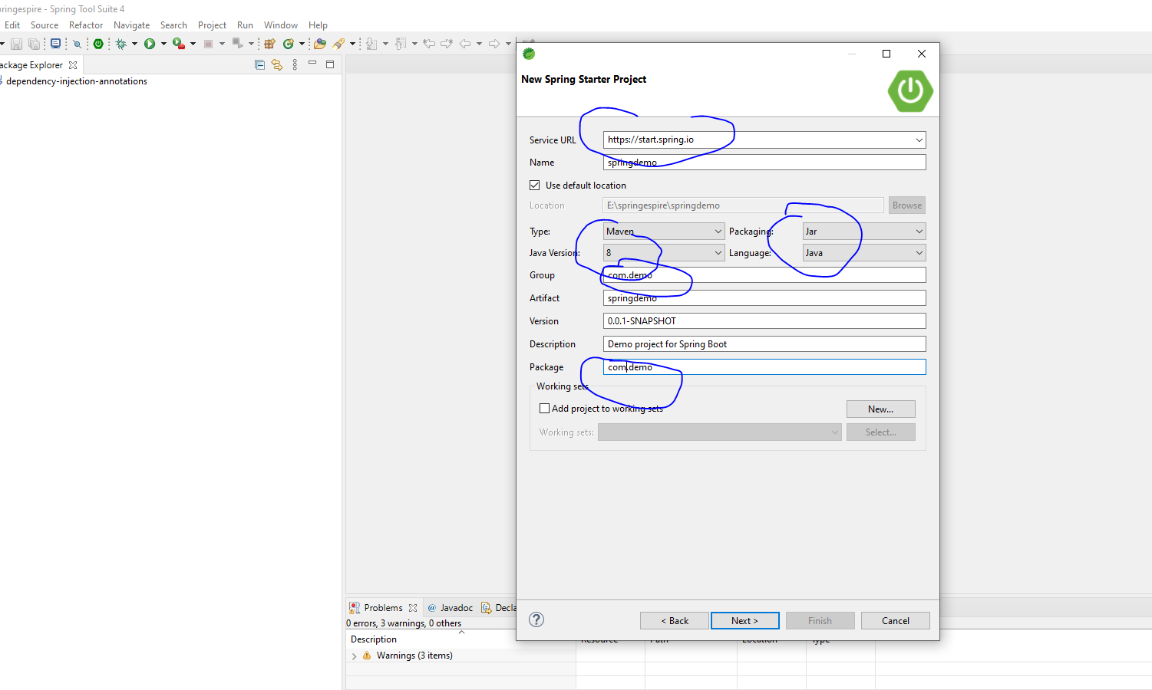
Step1

Slide 3
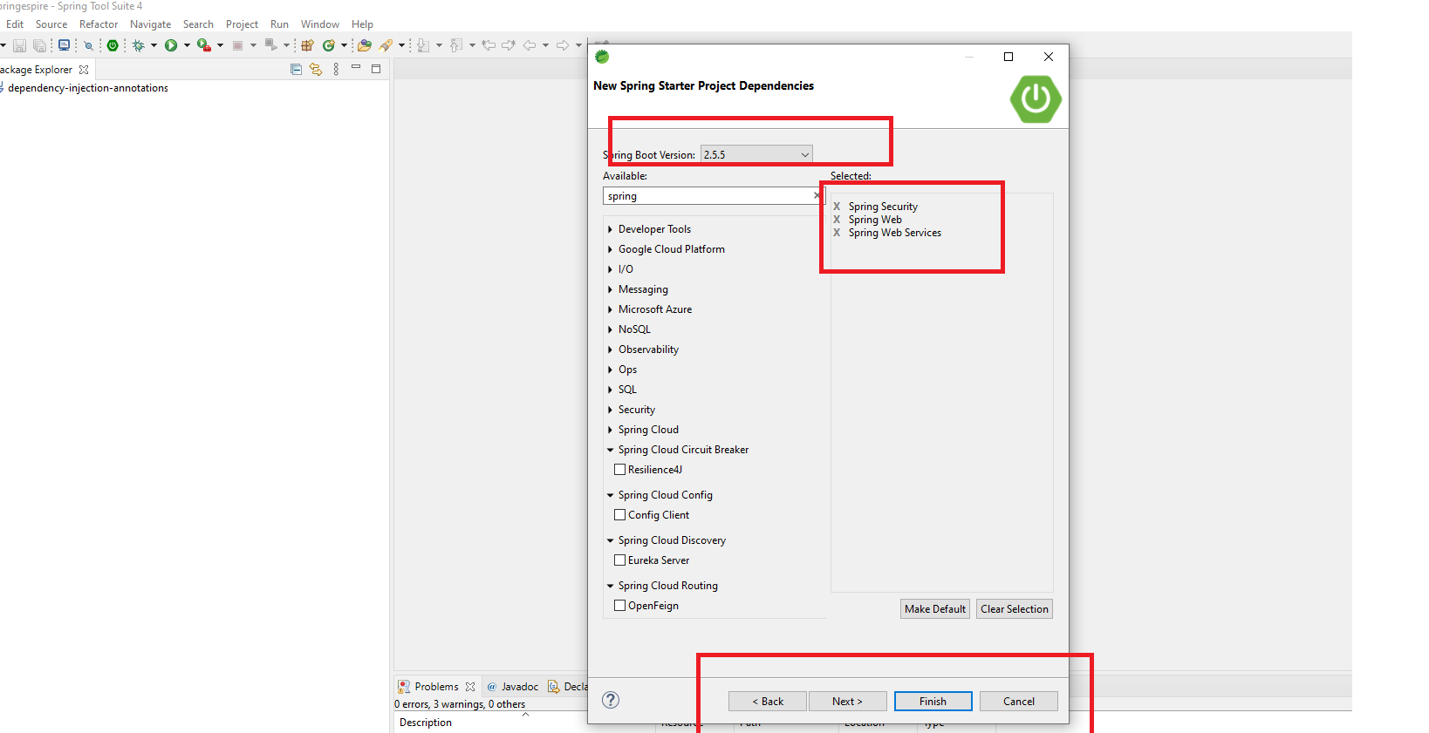
Step2

Slide 4
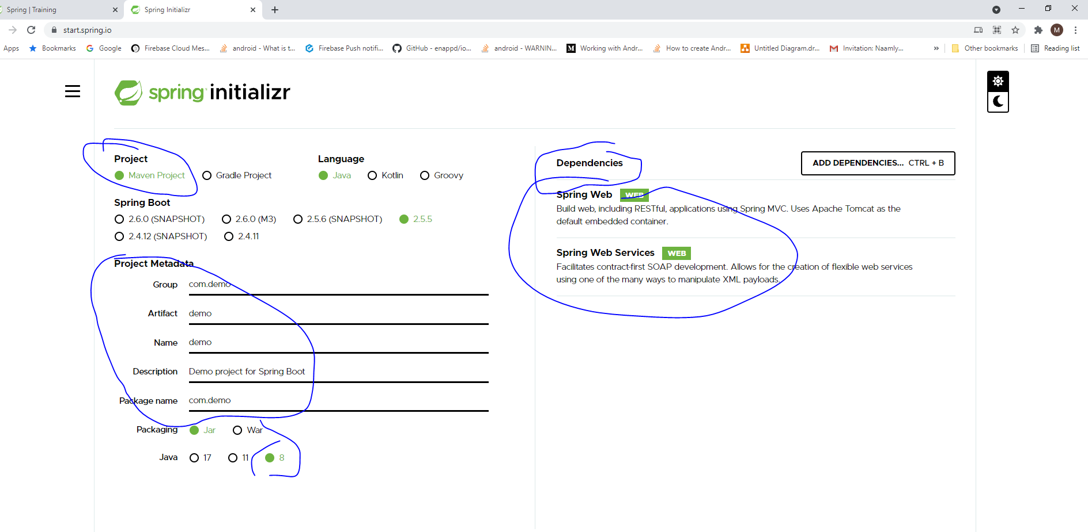

Slide 6
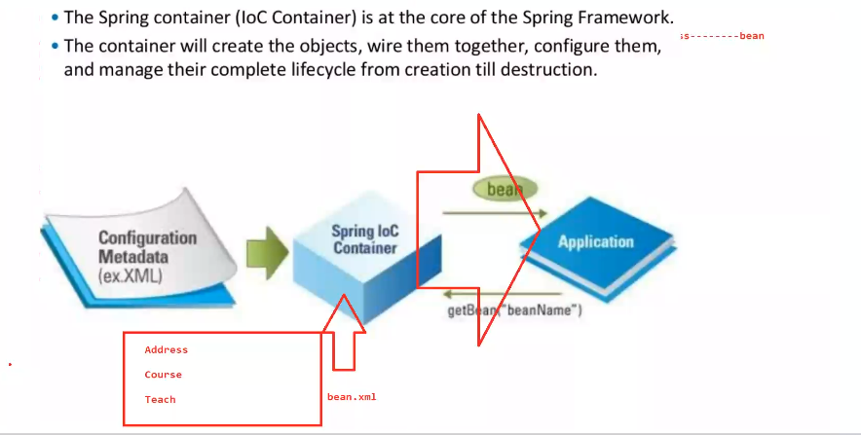
IOC Container

Slide 7
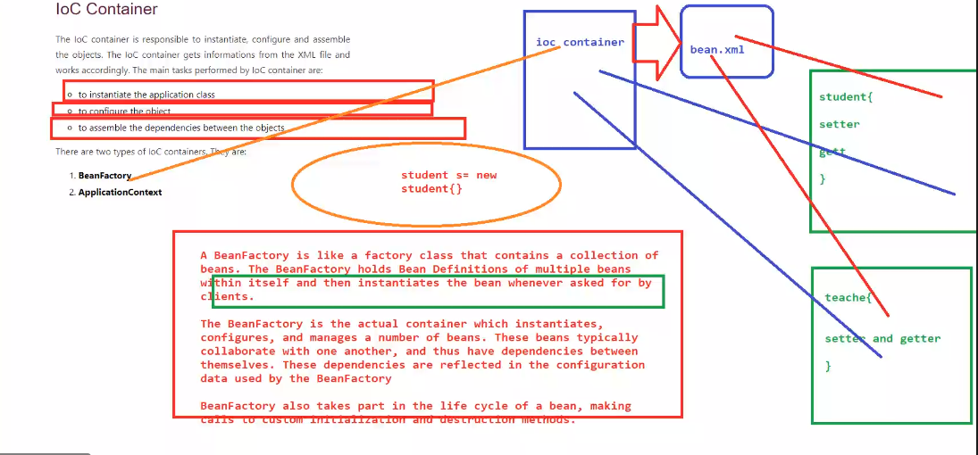

Slide 8
<!-- Spring and Transactions -->
<dependency>
<groupId>org.springframework</groupId>
<artifactId>spring-context</artifactId>
<version>${spring-framework.version}</version>
</dependency>
<dependency>
<groupId>org.springframework</groupId>
<artifactId>spring-tx</artifactId>
<version>${spring-framework.version}</version>
</dependency>

Slide 9
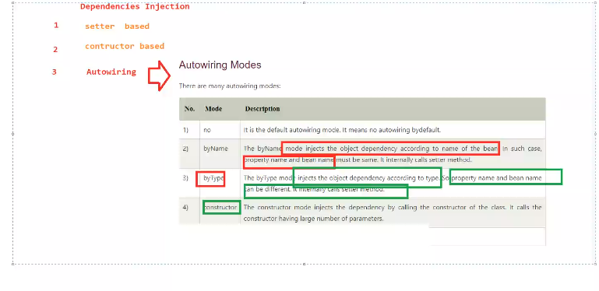

Slide 10
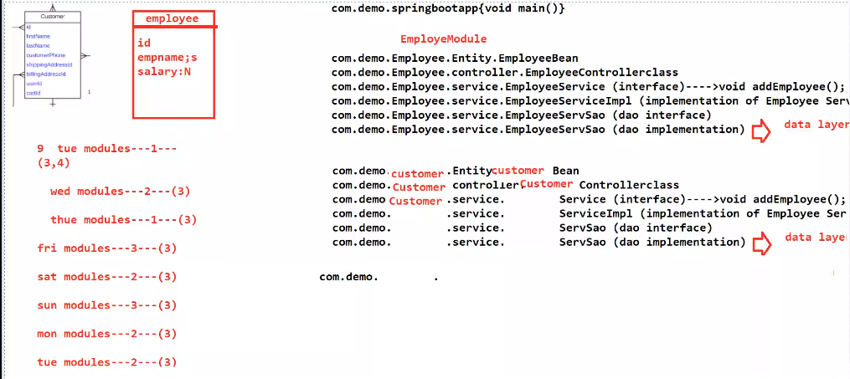

Slide 11
https://www.javatpoint.com/spring-JdbcTemplate-tutorial

Slide 12
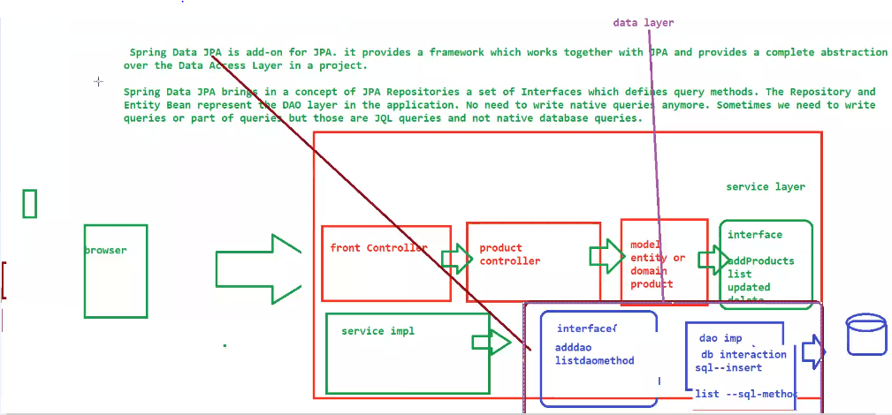

Slide 13
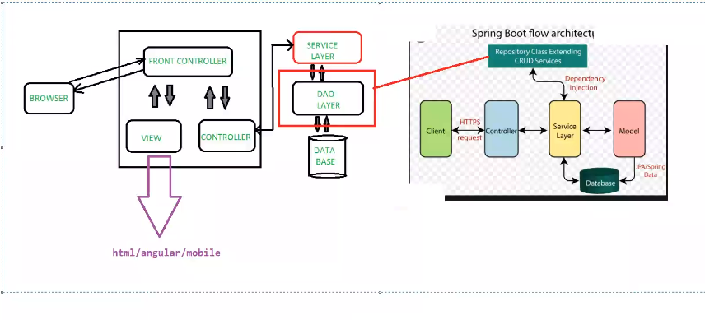

Slide 14
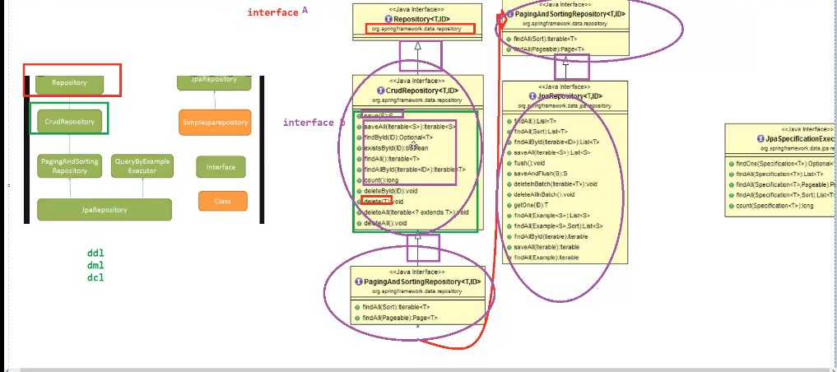

Slide 15
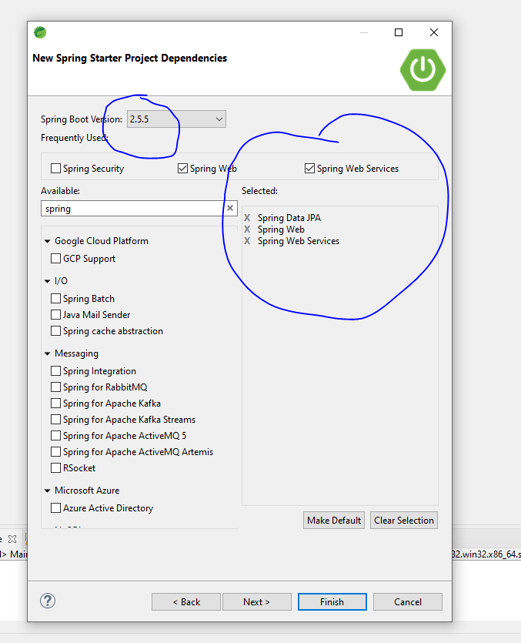

Slide 16
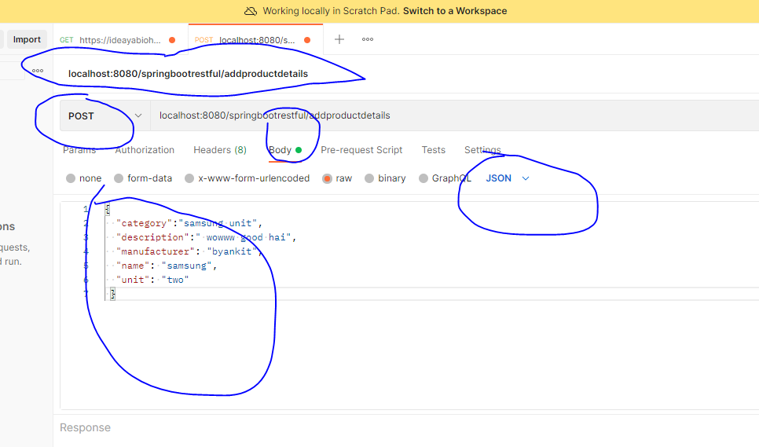

Slide 17
package com.demo.controller;
import javax.validation.Valid;
import org.slf4j.Logger; import org.slf4j.LoggerFactory; import org.springframework.beans.factory.annotation.Autowired; import org.springframework.validation.annotation.Validated; import org.springframework.web.bind.annotation.PostMapping; import org.springframework.web.bind.annotation.RequestBody; import org.springframework.web.bind.annotation.RestController;
import com.demo.model.Product; import com.demo.serviceimp.ProductServiceImpl;
@RestController @Validated public class ProductController { private final Logger LOGGER = LoggerFactory.getLogger(this.getClass()); //injecting the dependencies of product implementation @Autowired ProductServiceImpl service;
//inserting product details like id ,name,manufacturer @PostMapping("/addproductdetails") Product addProductDetails(@Valid @RequestBody Product product) { LOGGER.info("inside ProductController.addProductDetails() method");
Product prod = service.addProductDetails(product); LOGGER.info("demo of logger"); return prod;
}
}

Slide 18
logging.level.org.springframework.web=INFO logging.level.org.hibernate=ERROR logging.level.net.guides=DEBUG
logging.file=e://myapp.log
<dependency> <groupId>org.projectlombok</groupId> <artifactId>lombok</artifactId> </dependency>
@JsonFormat @NotBlank @NotNull @Size(min = 10, max =100) @Column(length = 255 ) private String name;

Slide 19
